Slide 1

Project in Data Science Course
Project Topic: Salary Prediction in the Hi-Tech Industry
Presented by: Avichai Gal Or and Sahar Agranov
Guided by: Shai Ziv, Ophir Herrera
Spring Semester 2023

Slide 2
Steps of the project
Step 1: Getting data from “Glassdoor” website
Step 2: Preprocessing the data
Step 3: Feature Engineering
Step 4: Exploratory Data Analysis (EDA)
Step 5: Machine Learning Process
Step 6: Conclusion

Slide 3
Step 1 - Getting the data from 'Glassdoor' website
Purpose: We aim to collect job data from the 'Glassdoor' website. However, we observed that the website restricts access to only 900 jobs per keyword, limiting our ability to gather comprehensive data. To overcome this limitation, we devised a solution by creating a list of keywords specific to each sector of interest. Approach: 1. We will utilize a custom scraper built with Selenium to automate the data collection process from 'Glassdoor.' 2. To ensure a broad coverage of job postings, we have curated a list of keywords that correspond to specific sectors. 3. By iterating through each keyword, we can gather a substantial amount of job data for analysis. Benefits: - Increased data availability: By using a diverse set of keywords, we can expand our dataset beyond the 900-job limit imposed by 'Glassdoor'. - Sector-specific insights: The use of sector-specific keywords enables us to focus our analysis on particular industries, facilitating deeper understanding and targeted recommendations. Note: The scraper and keyword list will be called from this main file to streamline the data collection process.

Slide 4
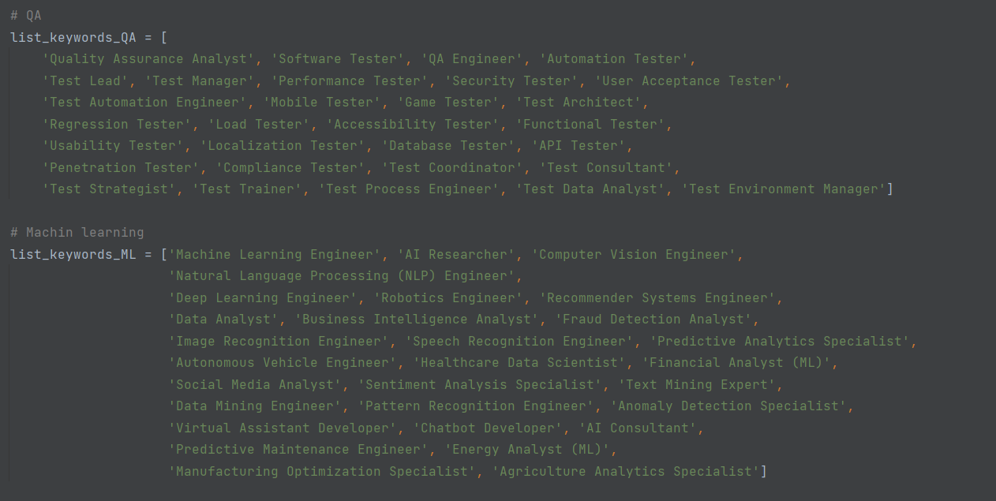
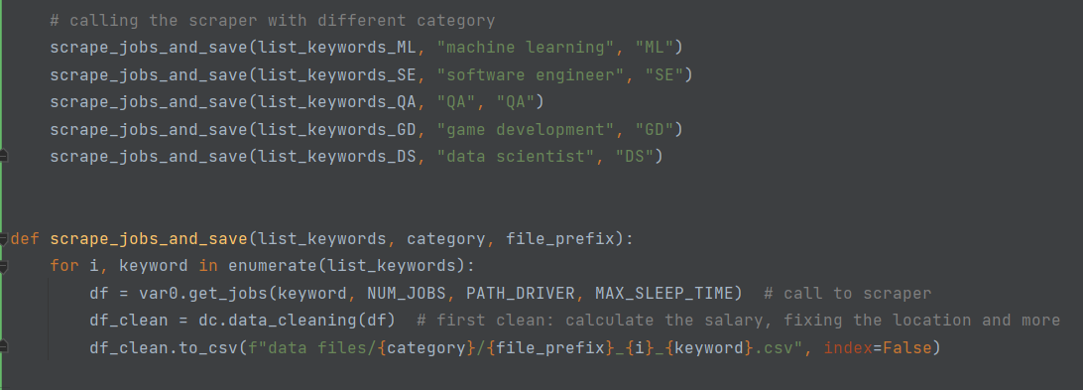

Slide 5
The Scraper Code
Purpose:
The purpose of this cell is to implement the scraper code that retrieves job data from the 'Glassdoor' website. However, we encountered significant challenges due to the complex structure of the website's job listings. Challenges Faced:
The 'Glassdoor' website organizes job listings in a nested list format, which presented difficulties in extracting the desired information. The job details were nested within multiple layers of lists and pagination. Approach:
To overcome the complexities of the website's structure, we devised a step-by-step approach for scraping the data: 1. Identify and locate the relevant HTML elements containing the job information. 2. Traverse through the nested lists and pages to access each job listing. 3. Extract the necessary details such as job title, company name, location, salary, and other relevant information. 4. Store the extracted data in a suitable data structure or format for further analysis. Benefits:
By successfully implementing the scraper code, we can gather comprehensive job data despite the website's intricate structure. This allows us to extract valuable insights and patterns from a large volume of job listings.

Slide 6
Step 2 - preprocessing data
In this section, the following tasks were accomplished:
Computation of 'Annual Salary' – This was essential to establish a single consistent parameter, as opposed to the original format which had salary stated per hour/month/year.
Feature Scaling – This involved scaling attributes such as "Company Size", "Revenue", etc.
Merging CSV files – The CSV files generated by different scrapers were consolidated into one.

Slide 7

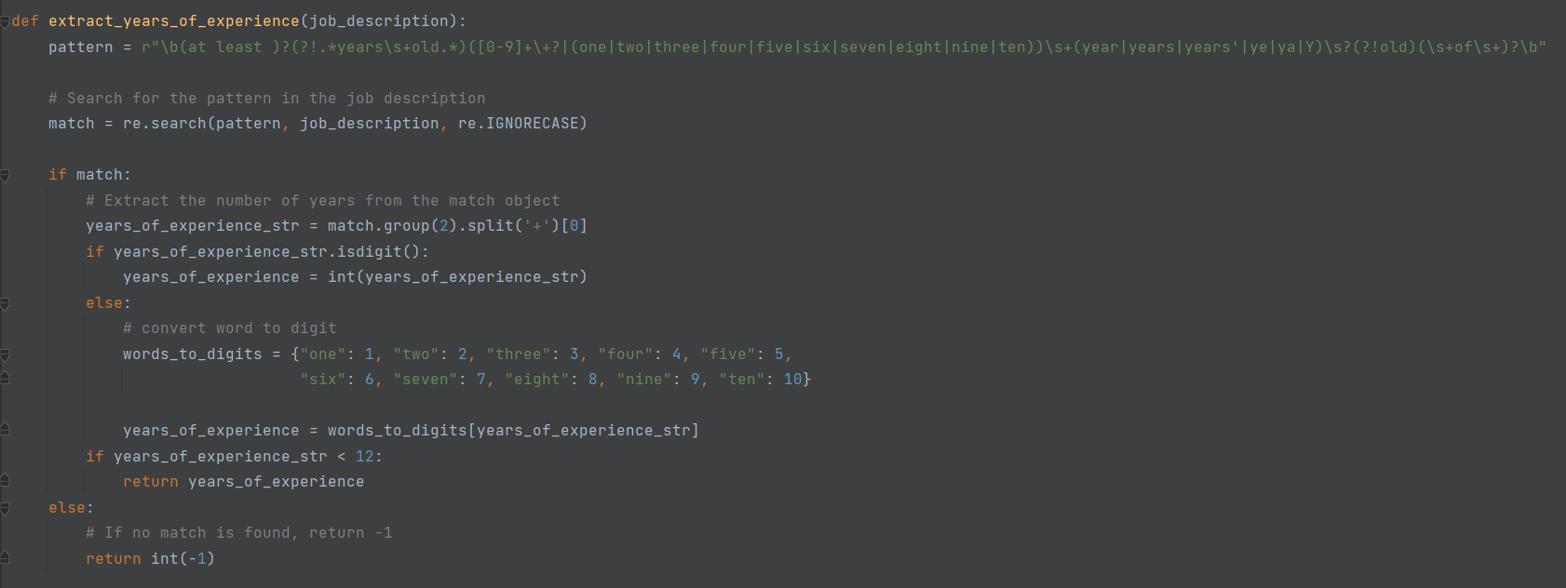
Step 3 - Feature Engineering
In this step, our goal was to gather pertinent data from the textual descriptions present in job postings. At the start, we implemented a naive methodology. However, this approach fell short of accurately discerning the necessary years of experience for a position.
Here is the code that was initially used:

Slide 8
Job Responsibilities: The Data Analyst (SQL) will be primarily accountable for the following Integrate data from multiple data sets, examine and interpret complex data sets and make findings relevant and actionable for both internal and external stakeholders Sett up, deploy, configure, and monitor multiple systems Provide timely, accurate and reliable management reporting and research of data Create innovative solutions to an extensive range of complex data requests Assist in the development of additional information system projects, as needed Verify data quality to ensure accurate reporting Job Requirements: Bachelors Degree in MIS, Statistics, Mathematics, Business Management, Computer Science or a related field and 2+ years of demonstrated experience (coursework or professional experience) with databases, SQL query development and at least one scripting language (Python, R, or other) OR a Master's Degree in above listed areas and 1+ years of experience. Must be detail-oriented with excellent data and quantitative skills. Demonstrated ability to apply innovative and resourceful solutions to solve challenges and the ability to meet detailed project goals while working autonomously. Must have excellent written and verbal skills with the ability to clearly organize thoughts and/or document content and convey complex concepts effectively regardless of audience Must be proficient with Microsoft SQL Server and SQL Reporting Services, Microsoft Excel, Microsoft Access and other database tools Why Work With Us? When you work with Cambium Assessment, you'll be helping to design and build inspiring solutions that make a real impact on the online testing industry, as well as the educators and students we support. Our systems are highly scaled and mission critical serving over a third of all students in grades 3-8 in the United States. Our web applications are highly interactive and universally accessible. Our machine scoring methods are driven by artificial intelligence allowing computers to perform such complex operations as grading essays with more accuracy than humans. Our processes use intensive algorithmic computing allowing a customized experience for each student as the exam adapts real-time based upon answers given. In the 2021-2022 school year, we delivered more than 100 million online tests, successfully supported peak testing volumes exceeding 1.3 million simultaneous test takers, while ensuring an average response time of less than a tenth of a second. We have the most advanced features of any online testing system, and we continue to push boundaries to improve student performance measurement and enabling educators with actionable insights to drive better overall educational outcomes for our students. To learn more about our organization and the exciting work we do, visit www.cambiumassessment.com An Equal Opportunity Employer We are dedicated to fostering a culture that celebrates unique backgrounds, ideas, and experiences. All qualified applicants will receive consideration for employment without discrimination on the basis of race, color, age, religion, sex, gender, gender identity/expression, sexual orientation, national origin, protected veteran status, or disability. To apply to this job, click Apply Now

Slide 9
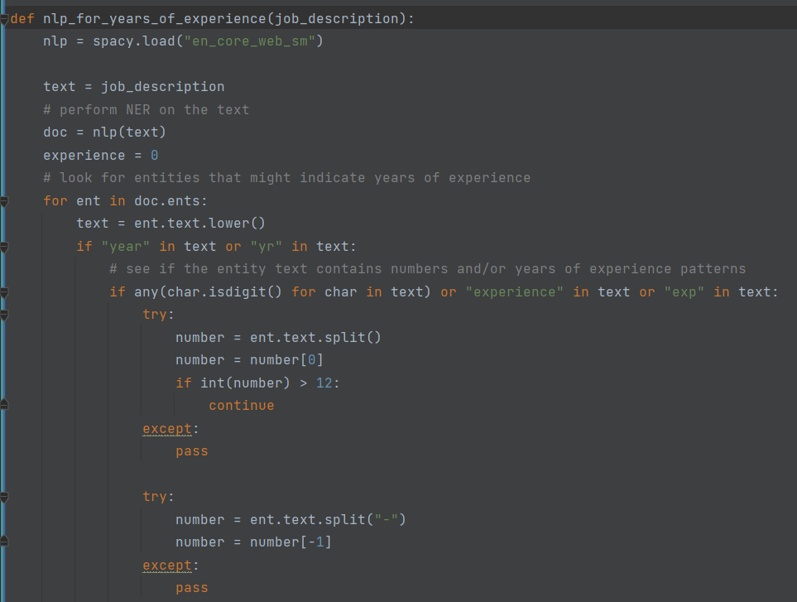
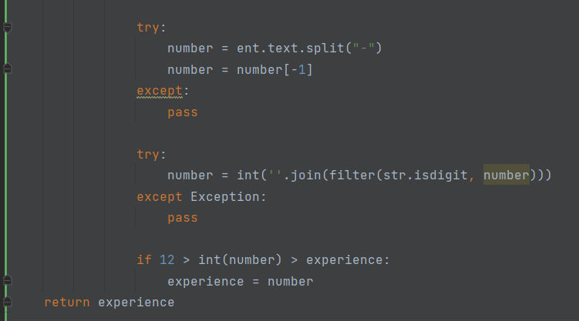
In the second technique, we have used NLP and made it :)
Approach:
We have created a function that utilizes natural language processing (NLP) and machine learning methods. The function analyzes the job descriptions provided by each company and extracts the required years of experience mentioned in the text. By leveraging an ML model capable of understanding English language patterns, we can extract this crucial information from the large and unorganized text.

Slide 10
Step 4 - Exploratory Data Analysis (EDA)
In this EDA step, we will perform the following tasks:
1. Display sample examples from the database to provide a visual understanding of the dataset's structure and content.
2. Explore the statistical summary of the variable inspecting the corralations.
3. Visualize the relationships between different variables and the target feature using appropriate plots, such as scatter plots, bar graphs, and voilntplot.
4. Analyze the distribution of 'Annual Salary' and identify any potential outliers or anomalies.
5. Conduct correlation analysis to determine the strength and direction of relationships between variables.

Slide 11
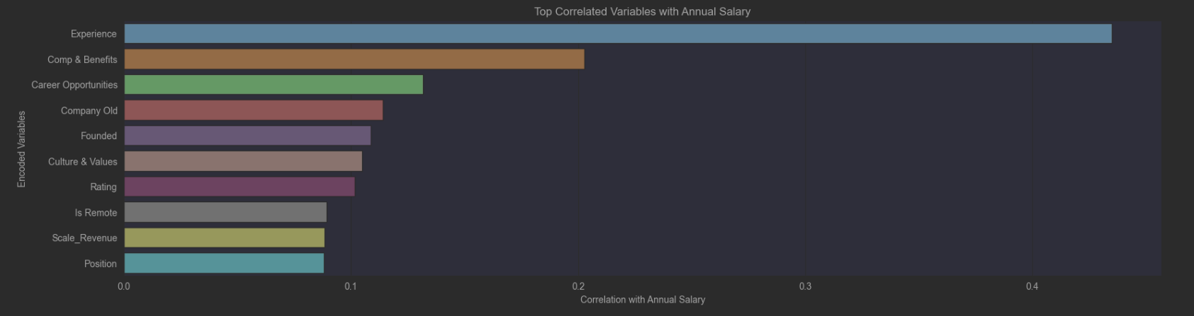
In the subsequent graph, it becomes clear that the features exhibiting the strongest correlation with the "Annual Salary" are "Experience" and "Compensation and Benefits".

Slide 12
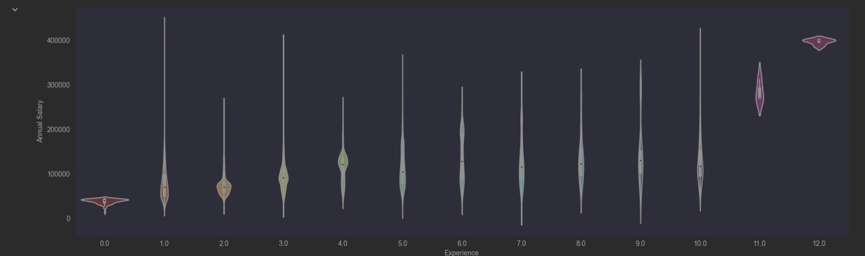
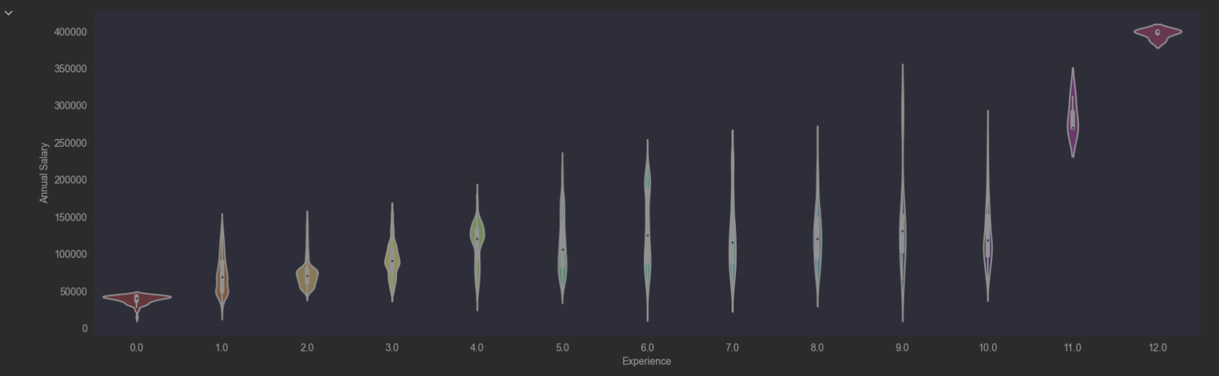
The subsequent two graphs display the differences before and after the removal of outliers.
'Annual Salary' correlation with 'Experience' changed from 0.493218 to 0.504554

Slide 13
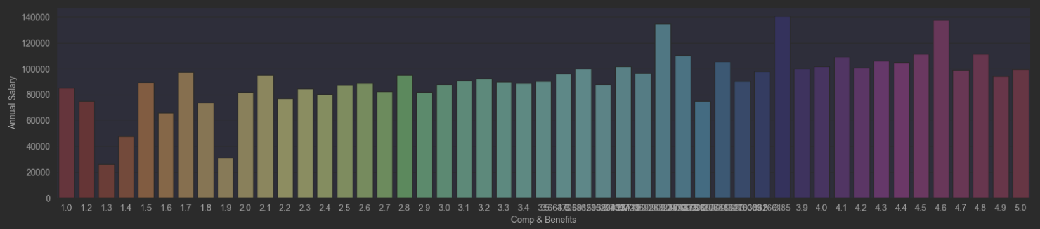
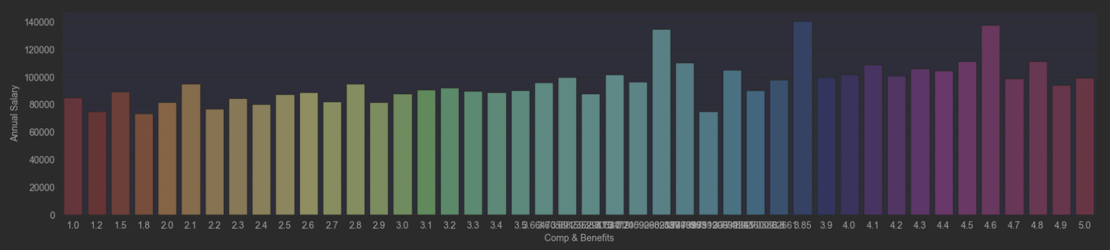
The subsequent two graphs display the differences before and after the removal of outliers.
Removing outliers didn't make real change

Slide 14
Correlation Analysis for Categorical Features
Approach:
In this section, we will follow these steps:
1. We will visualize the correlation results using appropriate plots, such as stacked bar charts or pie chart to provide a clear understanding of the relationships.
2. We will calculate the correlation between the encoded categorical features and the 'Annual Salary' variable using an appropriate measure, such as correlation ratio.
3. We will encode the categorical features using an appropriate encoding technique, such as one-hot encoding or label encoding.

Slide 15
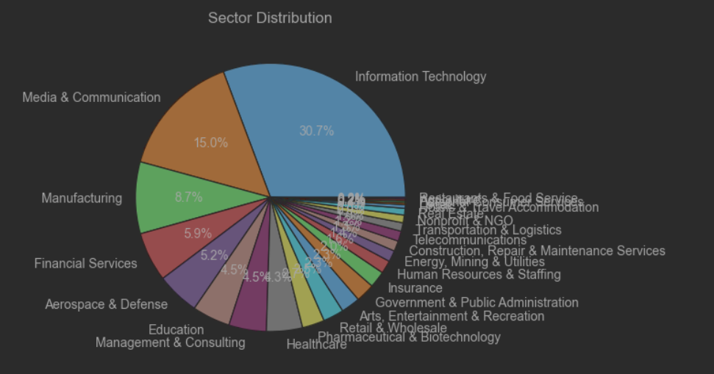
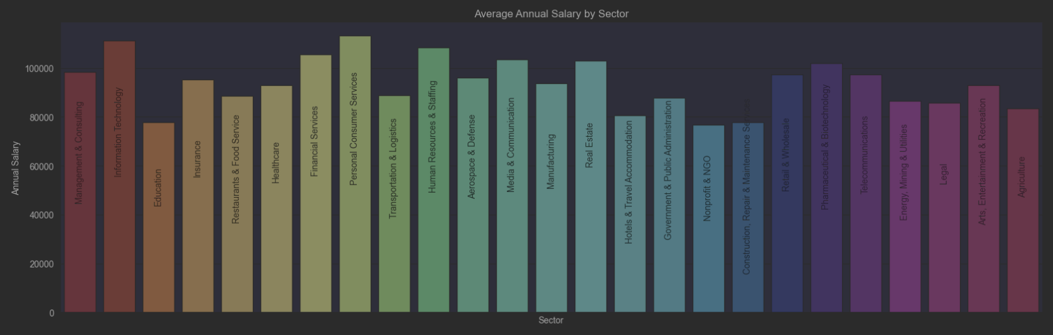
In the following two graphs, we can observe the division into sectors and their respective correlation to the "Annual Salary".

Slide 16
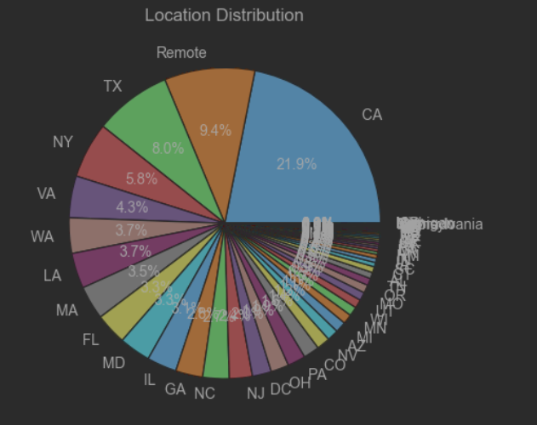
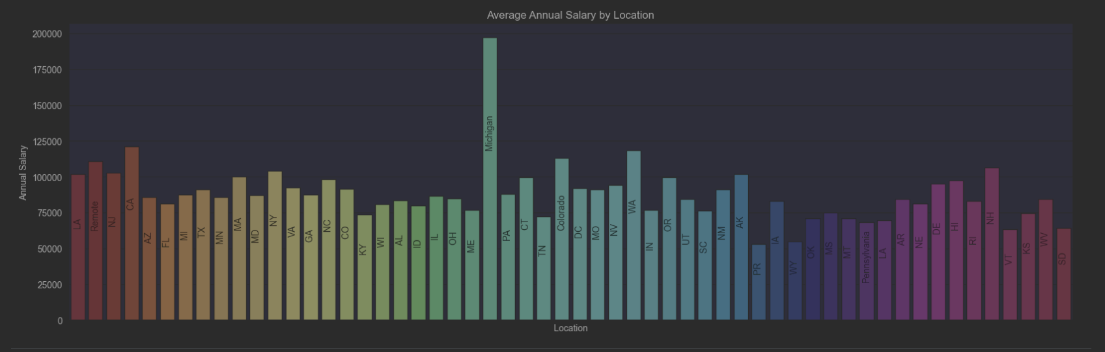
In the next two graphs, we illustrate the division based on locations and their corresponding correlation to the "Annual Salary". Notably, "Michigan" emerges as an outlier. Upon further examination, we decided to remove it.

Slide 17
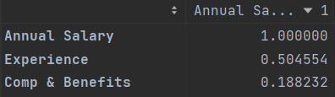
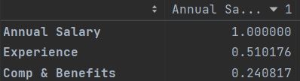
After the removal of outliers from these features, we can see a noticeable increase in the correlation pattern.

Slide 18
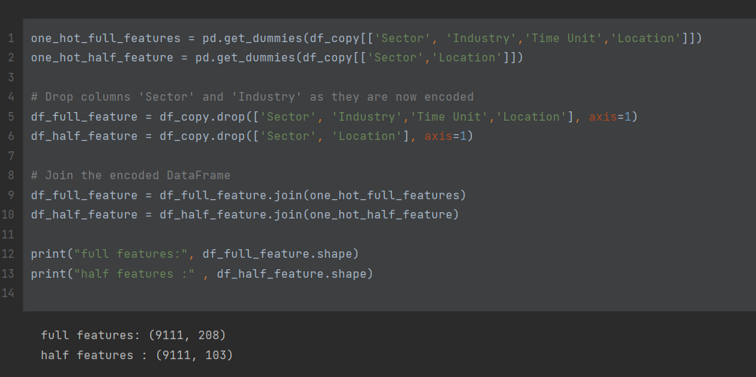
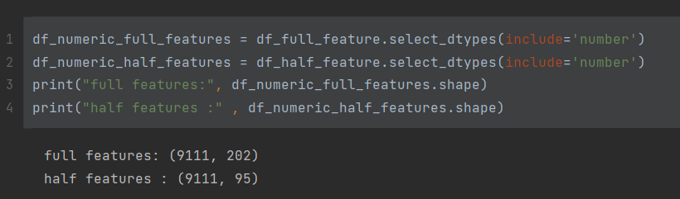
In this section we want to transfer the categorical features to binary to use them in the model
- For this transfer, we use 'One Hot Encoder' - There are two Dataframes, and we will try them both for checking which is the best Dataframe
All non-numeric columns were eliminated to properly fit the model.

Slide 19
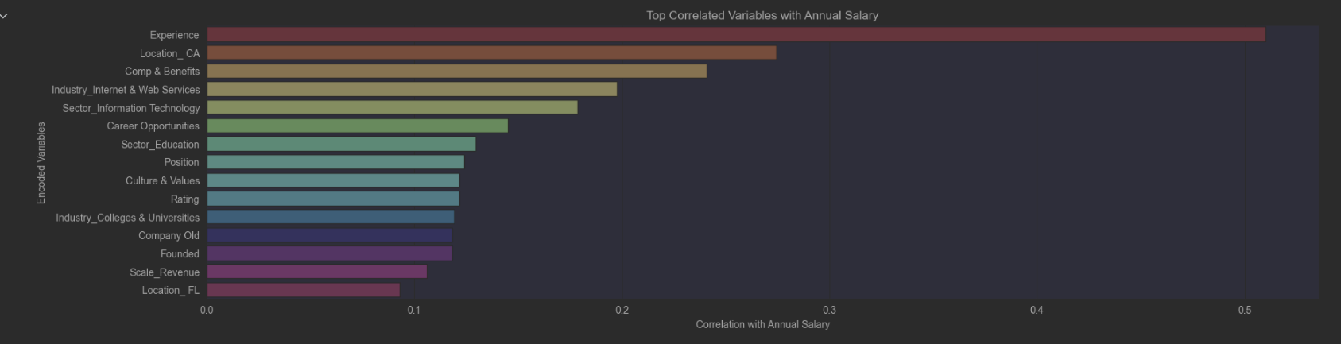
Following the removal of outliers and feature encoding, the subsequent graph demonstrates that new features are being examined to craft the most efficient model.

Slide 20
Step 5 - Machine Learning Process: Building and Training a Linear Regression Model with Full Features and Half Features
Purpose:
The purpose of this step is to apply machine learning techniques by building and training a Linear Regression model using a dataframes that includes all the relevant features. By utilizing the power of Linear Regression, we aim to create a predictive model that can estimate the 'Annual Salary' based on the available features.
Approach:
In this section, we will follow these steps:
1. Split the dataset into training and testing subsets to evaluate the model's performance.
2. Build a Linear Regression model using the training data, incorporating all available features.
3. Train the model on the training data to estimate the regression coefficients and intercept that best fit the data.
4. Validate the model's performance on the testing data to assess its ability to generalize well to unseen data.
5. Analyze the coefficients of the Linear Regression model to understand the relative importance and impact of each feature on predicting the 'Annual Salary.'

Slide 21
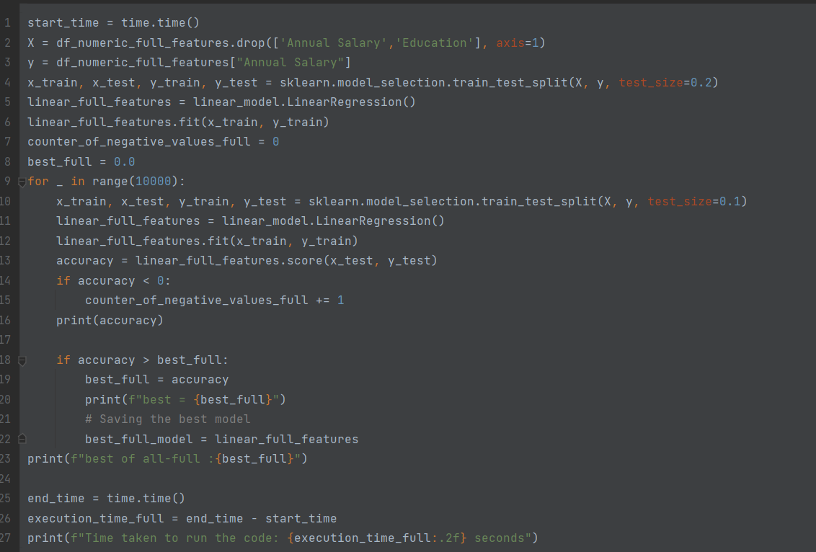
In this code segment, the building and training of the model are demonstrated. We employ a "for loop" and random data splitting to capture the best potential model.

Slide 22
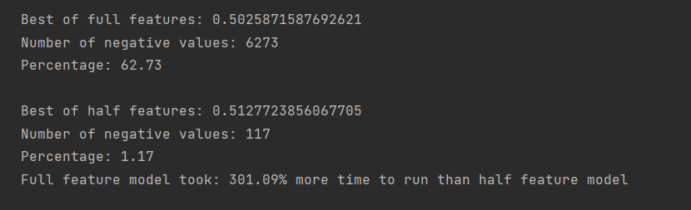

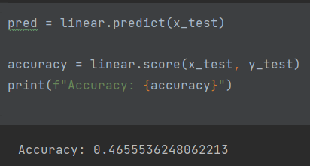

We conducted training on the model twice, initially using all the features we had and subsequently with half of the features. We then analyzed and compared the results of both approaches.
The second model, employing only half the features, outperforms the first one for the following reasons:
- Its predictive accuracy remains almost identical.
- It demonstrates a significant decrease in negative values (which serve as indicators of the model's quality)
- Its construction and training process are more time-efficient.
Then, we stored the optimal model that we derived in a pickle file. This will allow us to conveniently reuse it in the future as needed.
Testing the model that has been loaded.

Slide 23
Step 6 - Conclusion
Conclusion:
The salary in the global high-tech market is not consistent and is not solely dependent on a specific factor or a combination of specific factors. Our initial intuition that years of experience would have a significant impact on an employee's salary was not necessarily accurate. The global high-tech market is highly dynamic, and employees who have acquired experience in specific programming languages over the years may find themselves in less demand as new technologies emerge that can easily replace their roles. On the other hand, we recognize that new employees with extensive experience in sought-after programming languages can bring significant value. Furthermore, contrary to our initial intuitive stance, our research revealed that the defining characteristic of educational level has an influence that accounts for approximately half of the impact of location. For example, a computer science Ph.D. from India or Bangladesh may earn, on average, two-thirds of the salary of an employee with a moderate education level from California. The most significant fluctuations in the global market are driven by the breakthrough of innovative technologies that disrupt the status quo and change the rules of the game. For instance, the emergence of Artificial Intelligence (AI) and GPT has created tremendous demand for experienced programmers. Overall, our research demonstrates that the global high-tech market is complex and influenced by a variety of factors beyond just years of experience and educational background. Staying up to date with emerging technologies and continuously honing relevant skills is crucial for professionals in this field to navigate the ever-changing landscape successfully.

